Slide 1
New Wellness Center for Elizabethtown College
Kelly Bresnowitz
Jamey Hogarth
Rachel Lacek

Slide 2
Problem Statement
Elizabethtown College has been growing since it opened in 1899.
Enrollment increases faster than facility construction
Wellness resources are running low
Locker Rooms

Slide 3
Objective
Design a Wellness Center that follows LEED guidelines.

Slide 4
What is LEED?
LEED = Leadership in Energy & Environmental Design
Green building certification program
Certain amount of points must be earned
Different levels of certifications

Slide 5
Location

Slide 6
Location
Between turf field and soccer game field
Near center of campus
Should attract students from various locations
Already cleared land
Reduce costs

Slide 7
Additional Parking

Slide 8
Parking Garage
Convenient parking
Smaller footprint than a large parking lot
Lower Floors for faculty
Higher floors for residents

Slide 9
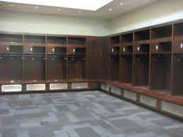
Wellness Center Basement
8 locker rooms
3 mens/womens
2 official/coach

Slide 10
Locker Room Usage - Fall
New Locker Rooms
Thompson
Women’s Soccer
Men’s Soccer
Field Hockey
Women’s Cross Country
Men’s Cross Country
Women’s Volleyball

Slide 11
Locker Room Use - Winter
New Locker Rooms
Thompson
Women’s Indoor Track
Men’s Indoor Track
Women’s Basketball
Men’s Basketball
Women’s Swimming
Men’s Swimming
Wrestling

Slide 12
Locker Room Use - Spring
New Locker Rooms
Thompson
Women’s Lacross
Men’s Lacross
Baseball
Softball
Women’s Tennis
Men’s Tennis

Slide 13
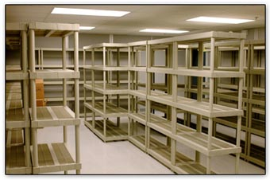
Basement
Storage Room
Athletic Equipment
Can never have too much storage

Slide 14
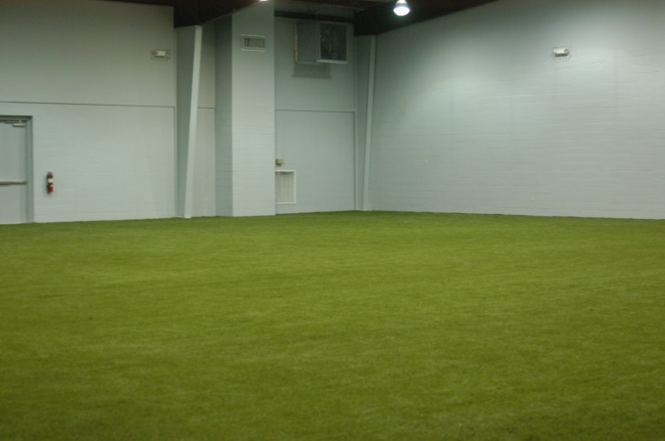
Basement
Turf Room
Used for off season sports
Soccer, baseball, softball, lacross, field hockey
Better than a hardwood floor
Less damage to Thompson’s wood floor
Indoor field intramurals

Slide 15
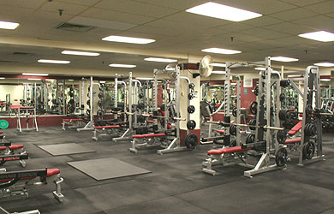
Basement
Gym & Weight Room
Body Shop and Athletic Weight Room are very small
Reduce Crowdedness
More machines and free weights

Slide 16
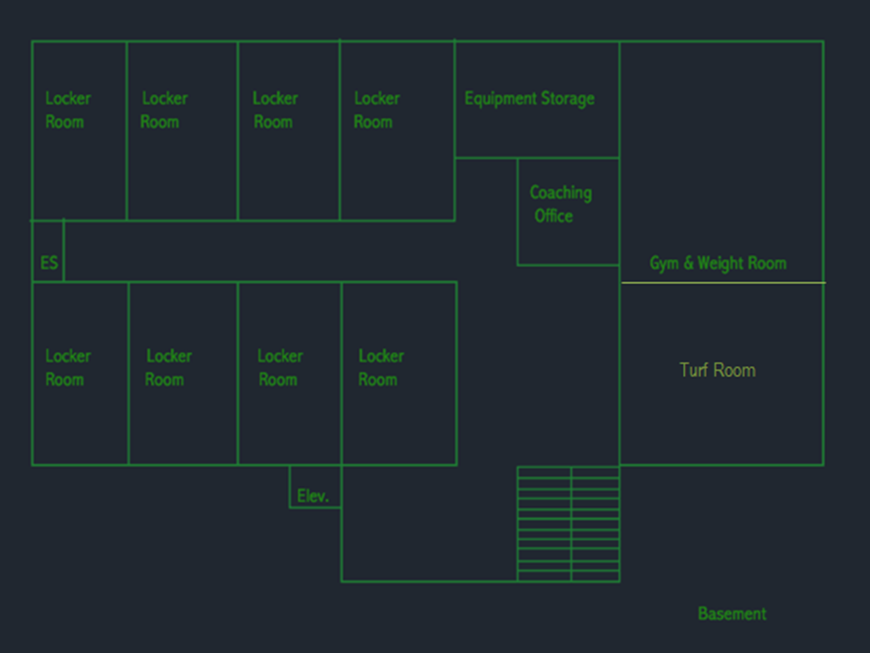

Slide 17
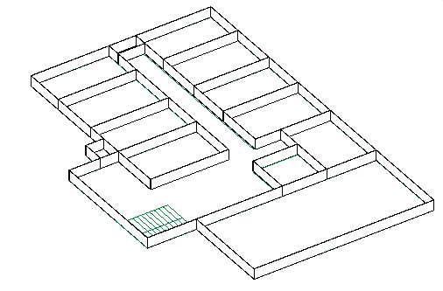

Slide 18
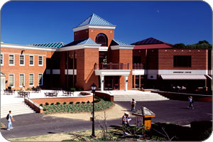
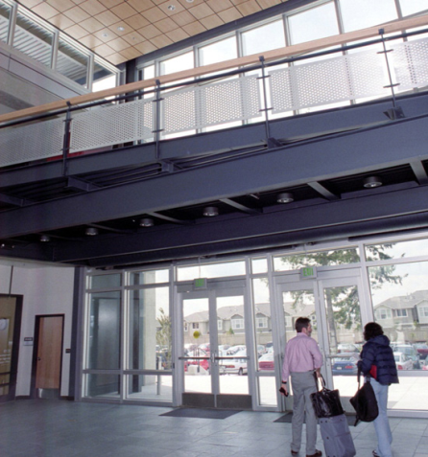
Ground Floor
Patio
Outdoor seating
School Work
Eating
Socializing
Elevator/Stairs
Atrium
Additional Seating

Slide 19
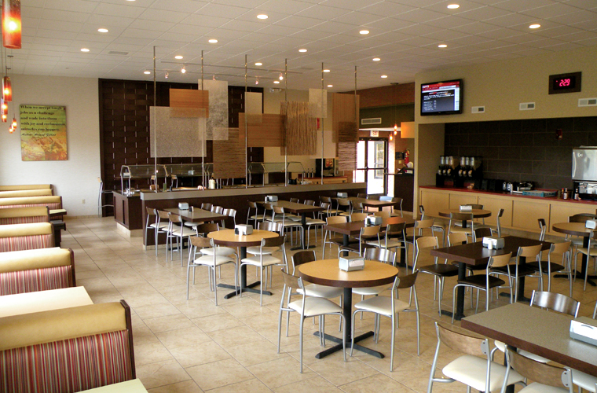
Ground Floor
Second Cafeteria
Uses meal swipes, not Jay Bucks
Eat in or Take out
Reduce Marketplace Crowdedness during peak times

Slide 20
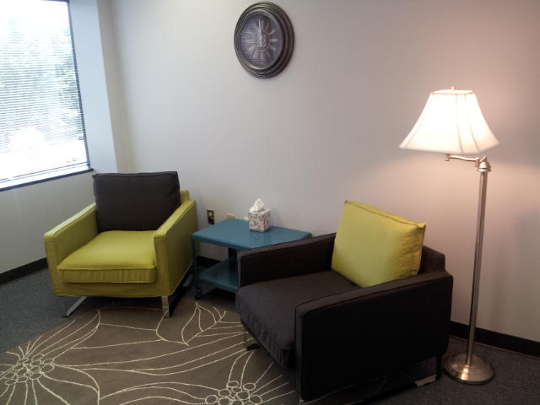
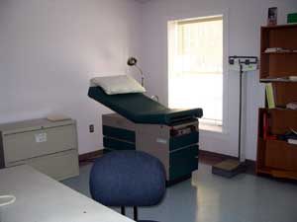
Ground Floor
Counseling Services
Move out of BSC
Located in back so students are not embarrassed to go
Nurse’s Office
Now located on Campus

Slide 21
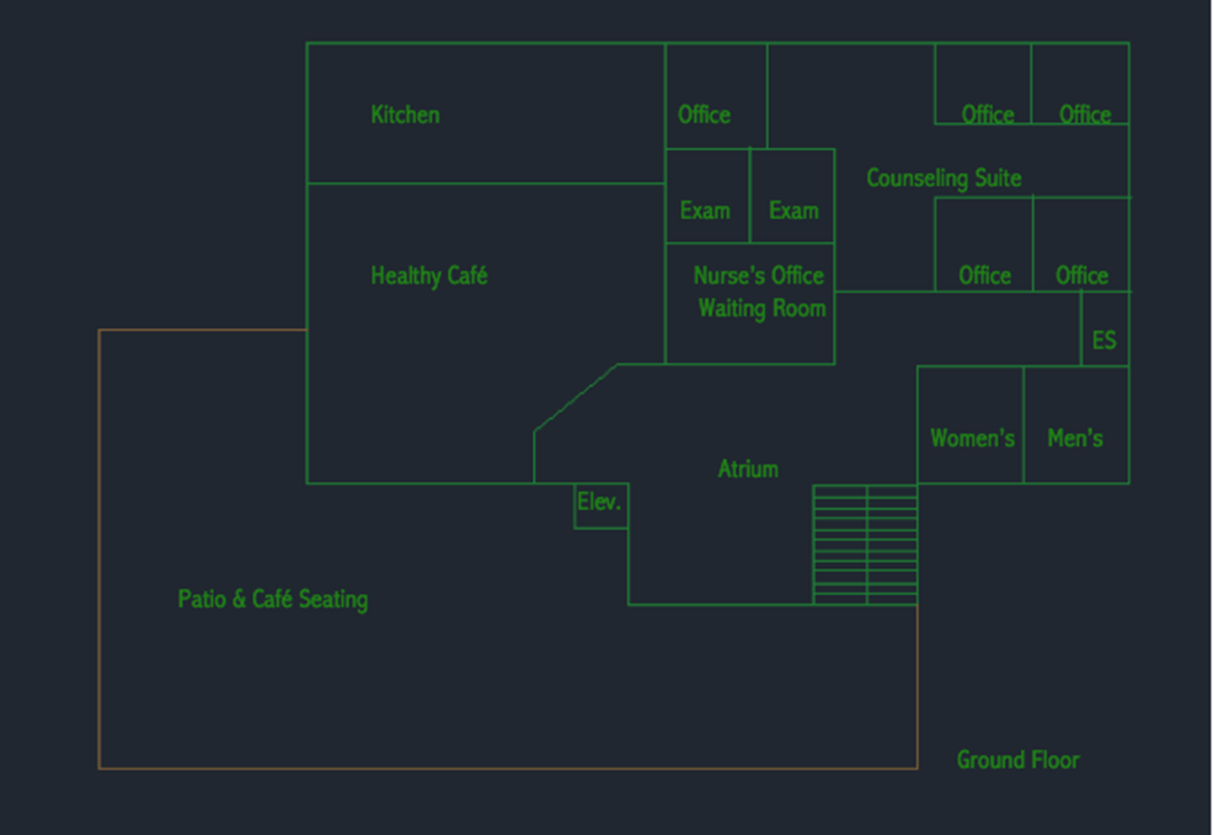

Slide 22
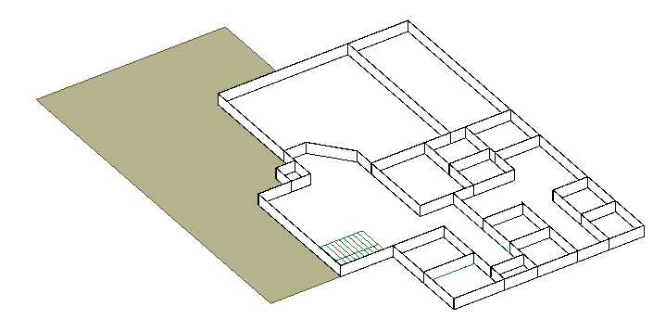

Slide 23
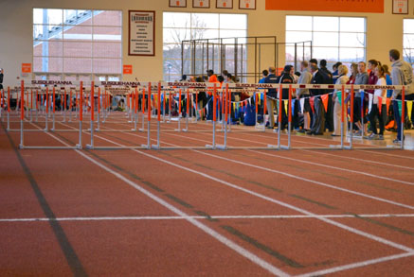
Second Floor
Regulation Size Indoor Track
Competitions can be held
Off season training
Possibility of fun school track competition
Intramurals
Bleachers for spectators
Indoor running option for non-athletes
Not a tredmill

Slide 24
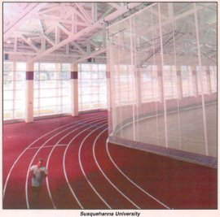
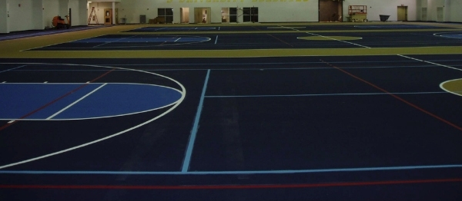
Second Floor
Basketball Courts
Not wood
Main use for intramural teams
Large area for off season team training
Curtain partitions to separate track and courts

Slide 25
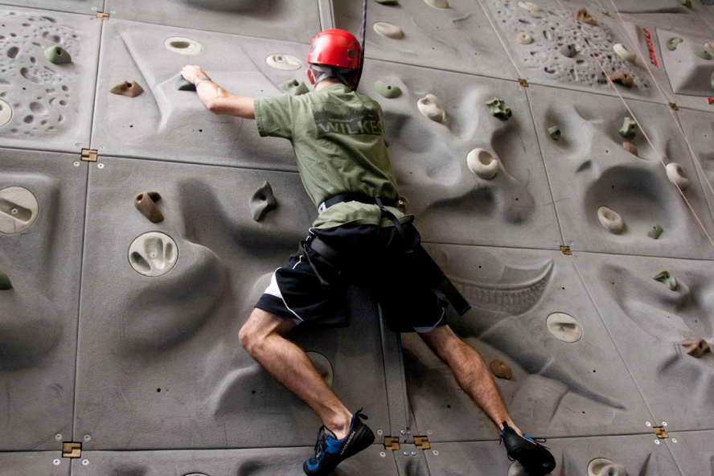
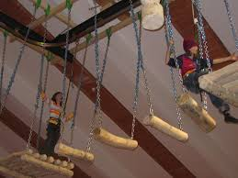
Second Floor
Rock Wall
Adventure Club/Climbing Club
High Ropes Course
Suspended above track
Sports Team Bonding
Outside Groups

Slide 26
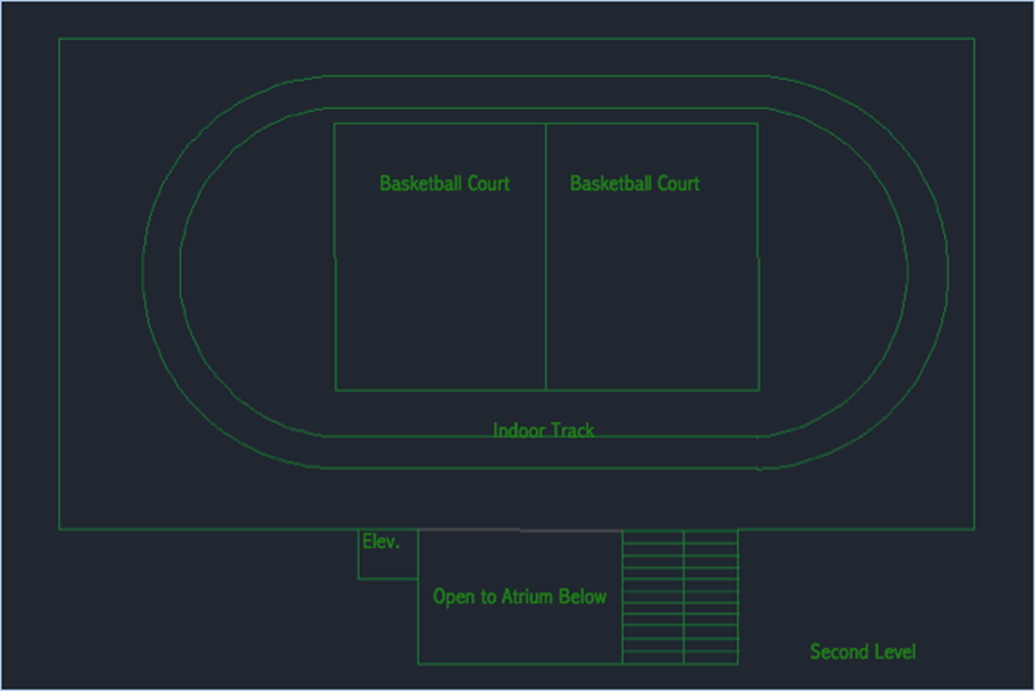

Slide 27
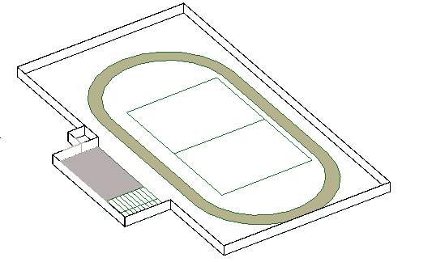

Slide 28
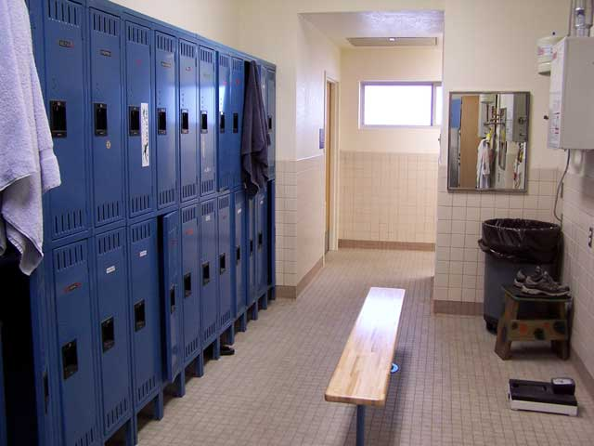
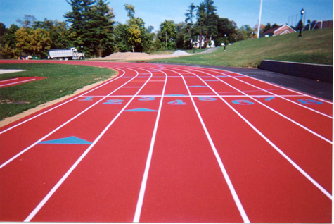
Additional Work
Redo Roof in Thompson
Leaking
Redo Track Surface
Redo Older Locker Rooms
Repaint Racquet Ball Rooms

Slide 29
LEED Certification
Gray Water Utilization
Bike Racks Outside
Reduced Parking Footprint (Parking Garage)
Water Metering
Indoor Water Use Reduction
Outdoor Water Use Reduction
Refrigerant Management
Renewable Energy Production

Slide 30
LEED Certification
Storage and Collection of Recyclables
Waste Management
Green Vehicle Preferred Parking (in Parking Garage)
Sunlight Utilization
Tobacco Smoke Control
Acoustic Performance
Innovation

Slide 31
Questions?

